Slide 1
Group Sales made Easy
Welcome!
Gettysburg Convention & Visitors Bureau
December 6, 2013
Presented By: Lois Stoltzfus, CTIS

Slide 2
What is a Group Sales Professional?

Slide 3
Group Leader
Tour Operator
Receptive Operator
Supplier

Slide 4
Who is your
Customer ?
Your customer is the person or company who actually pays the invoice.
Don’t confuse the customer with the end user,
or the person who uses or consumes your product.

Slide 5
Tiered Pricing
 | Property A | Property B | Property C | Property D
Rack Rate | $129.00 | $44.00 | $37.00 | $5.50
Group Rate | $99.00 | $42.00 | $31.00 | $4.25
Operator Rate | $89.00 | $40.00 | $29.00 | $4.00
Receptive Rate | $84.00 | $39.50 | $27.00 | $3.75

Slide 6
Disclosure
When confirming reservations by mail. Fax, or email; your confirmations should always include:
Unit Cost (including all non-discretionary costs such as taxes, gratuities, and service fees).
Number of unites reserved (23 rooms, 46 meals).
Schedule or time service is to be preformed.
Deposit, final payment and refund policies, and cancellation date.
Your name, and the name of someone else in your office authorized to make changes or quote rates relating to the reservation.
Your telephone number, mailing address (both postal and email), and fax number.
Temporary or seasonal modifications to your normal operating procedures (restaurant closed until may for renovations -or- park open weekends only January-March).
Temporary or permanent modifications to highways in your vicinity (exit 15 closed for repaving until April 3 – buses should use exit 14, and go south on Route 99 to our facility).

Slide 7
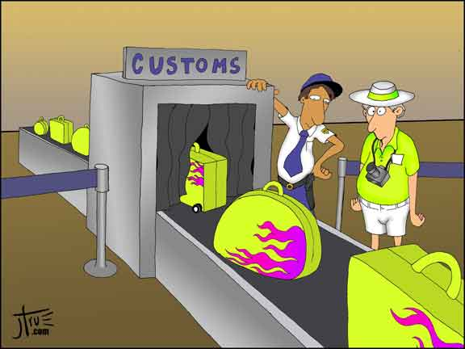
To exceed expectations, your confirmations should also include:
Detailed map showing a preferred route to your property.
Local motorcoach service facilities (repair, fuel, sanitary dumping).
Passenger coupons or incentives (free beverage in our lounge -or- 25% discount in our gift shop).
Other pertinent information about available services.

Slide 8
Abbreviations
ABA
ADA
CTIS
DMO
CVB
DOS
FAM
NTA
OMCA
RFP
ROI
SMERF
SYTA
TA
American Bus Association
Americans with Disabilities Act
Certified Travel Industry Specialist
Destination Marking Organization
Convention & Visitors Bureau
Director of Sales
Familiarization Tour
National Tour Association
Ontario Motorcoach Association
Request for Proposal
Return on Investment
School, Municipal, Education, Religious, Fraternal
Student & Youth Travel Association
Travel Agent

Slide 9
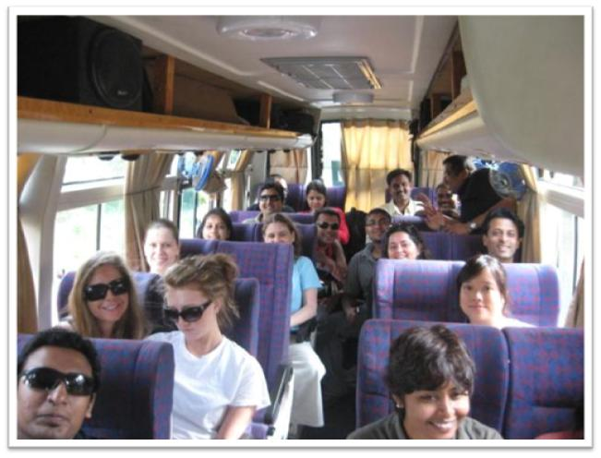
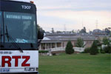
Preparing Your Property for
24 Tons Of Fun

Slide 10
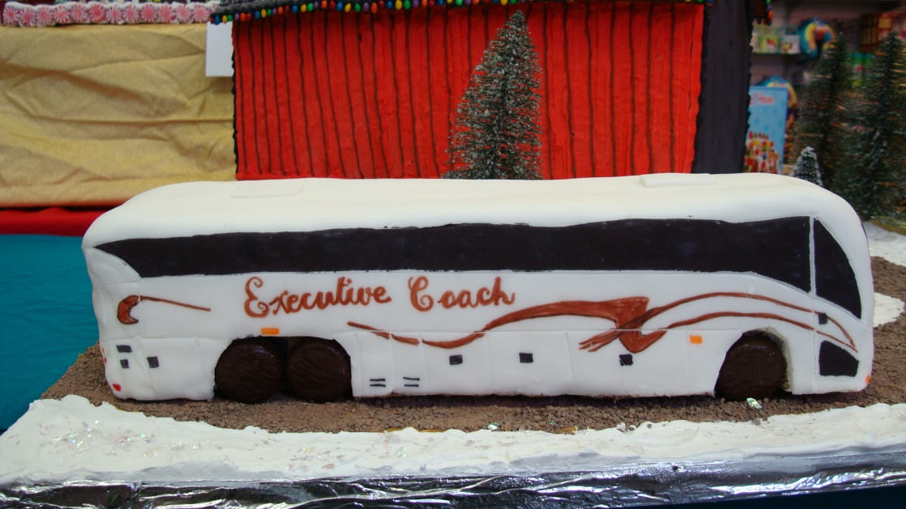
MOTORCOACH
What is a …

Slide 11
Motorcoaches are very BIG!
Company | Weight | Length | Width | Height | Turing Space
MCI | 48,000 lbs | 45’ | 102’ | 11’6” | 42”
Prevost | 48,600 lbs | 45’ | 102’ | 12’1” | 45.6’
Setra | 34.080 | 45” | 102’ | 11’9” | 35.5”

Slide 12
Motorcoaches are very tall.
Motorcoaches don’t maneuver very well.
Motorcoaches don’t like obstacles.
Motorcoaches don’t like surprises en route.
Motorcoaches require special servicing.
Motorcoaches are not an inconvenience.

Slide 13
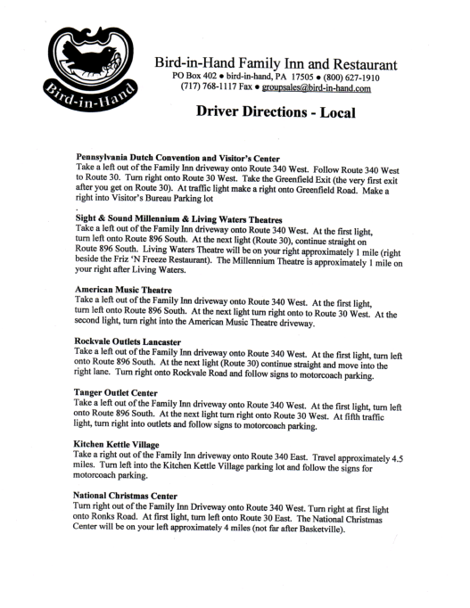
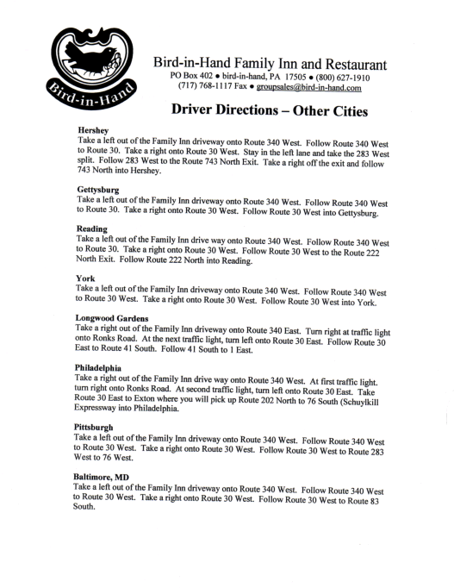

Slide 14
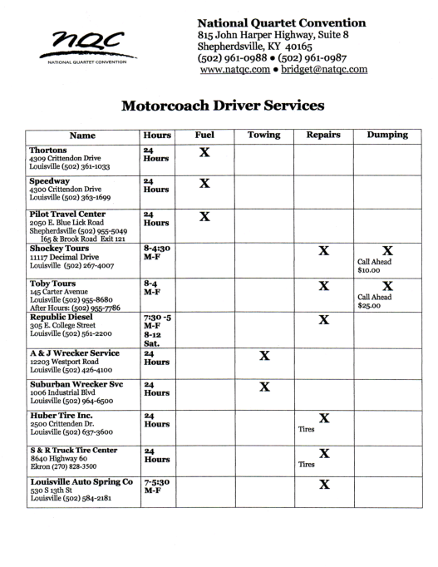
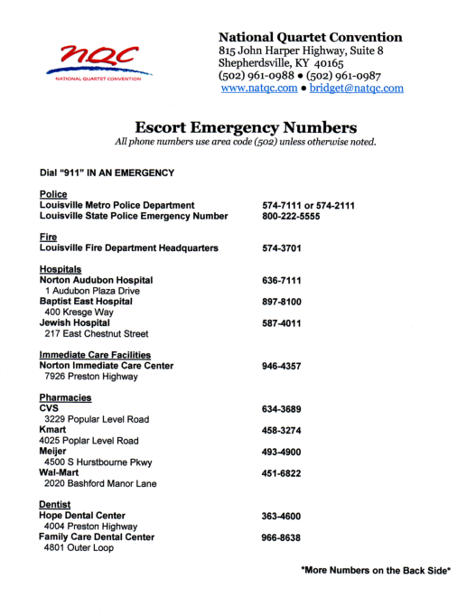

Slide 15
Don’t Neglect the Driver!
Federal Driver Regulations:
Driving: 10 Hours in a 15 hour period (day)
On Duty, Not Driving: stops, luggage, waiting
Off Duty (physically away from the coach): 8 Hours

Slide 16
Profile Sheets

Slide 17
Profile Sheet Specs
Standard Size – 8 ½ x 11
1” Left Hand Margin
Three Hole Punched
Feature Characteristics – Easy to Read, Bullets, Clear Font & Size
What’s New
Detailed Description of Your Services
Pricing, Group Policies, Incentives
Maps, Calendar, Schedule of Events
Pictures - Lifestyle
Utilize Corporate Colors if Possible
Build Awareness & Recognition
Bold is NOT Always Better
Utilize Logos or Branding Elements
Use individuals as Branding
Put Your Photo On It
Create multiple profiles to fit individual trade shows, tour companies, etc.
Print in-house which allows for variation.

Slide 18
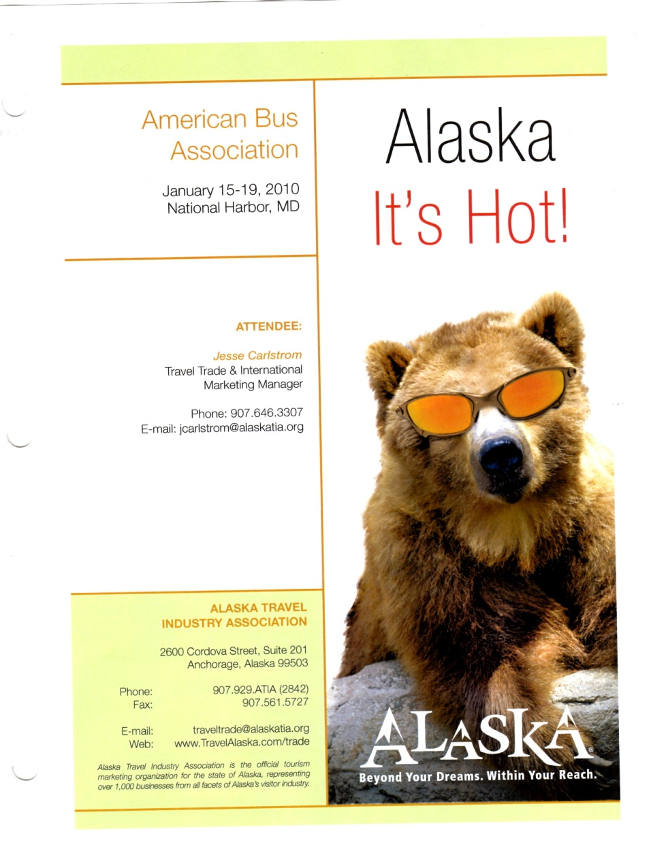
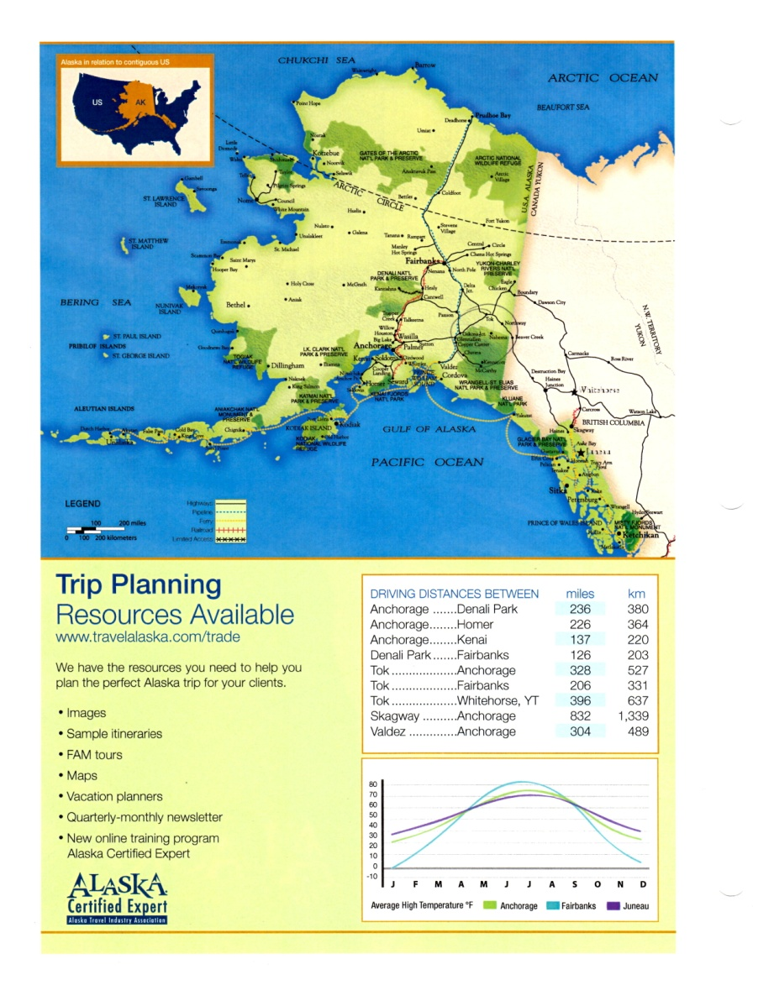

Slide 19
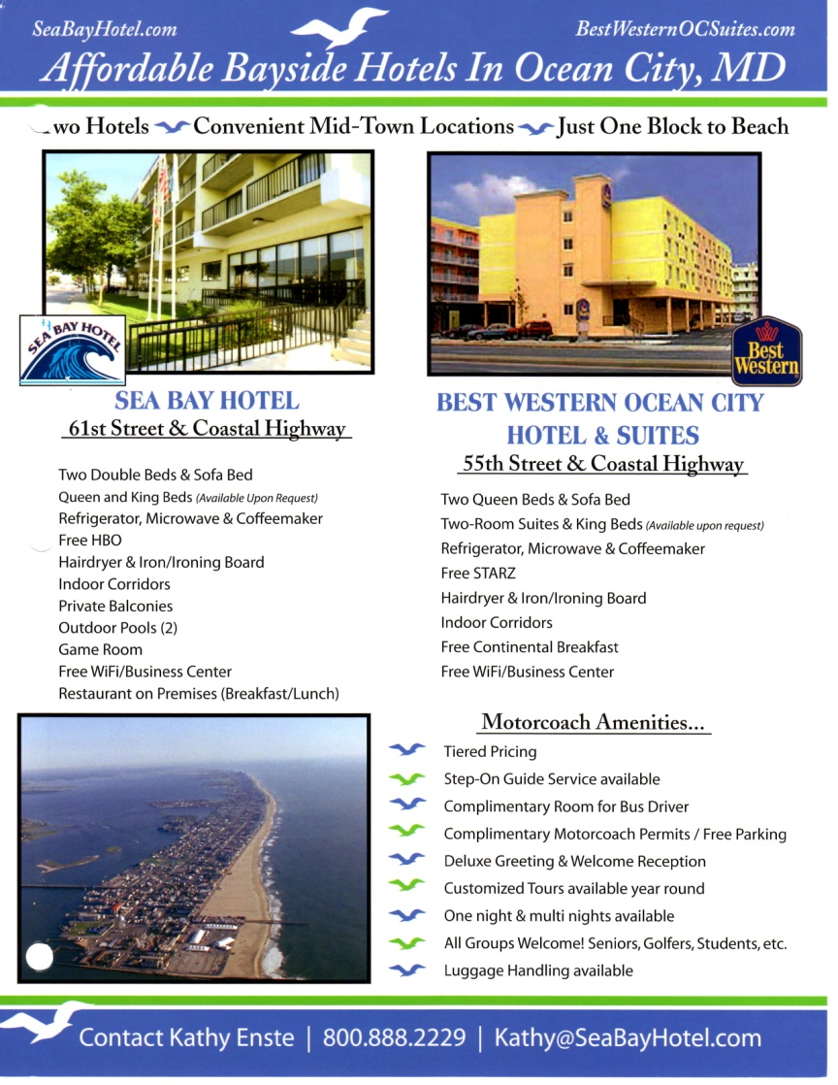
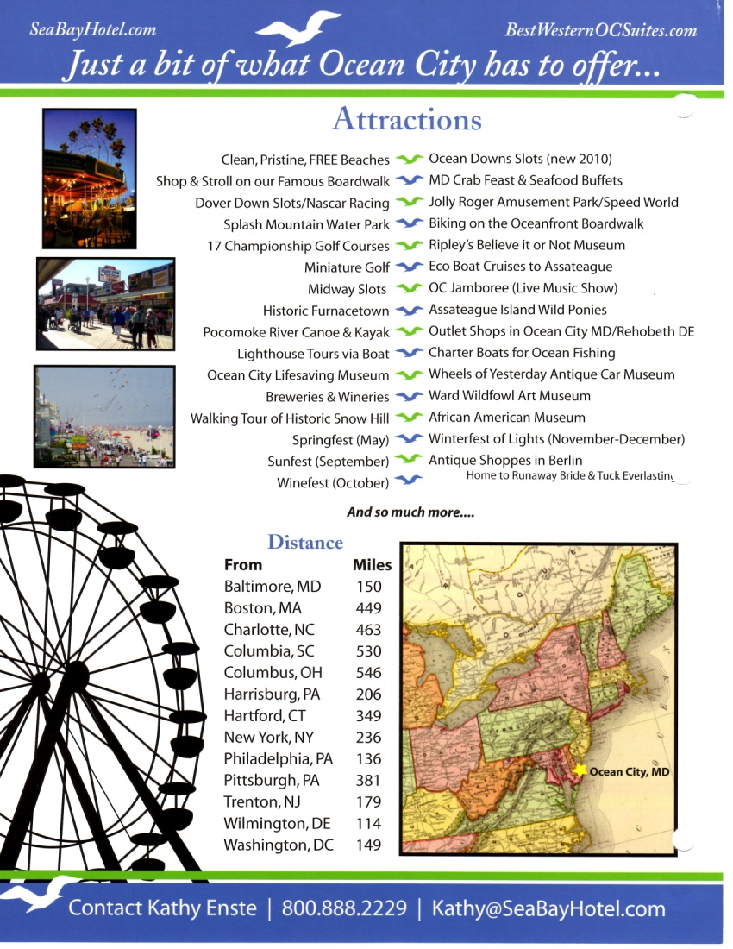

Slide 20
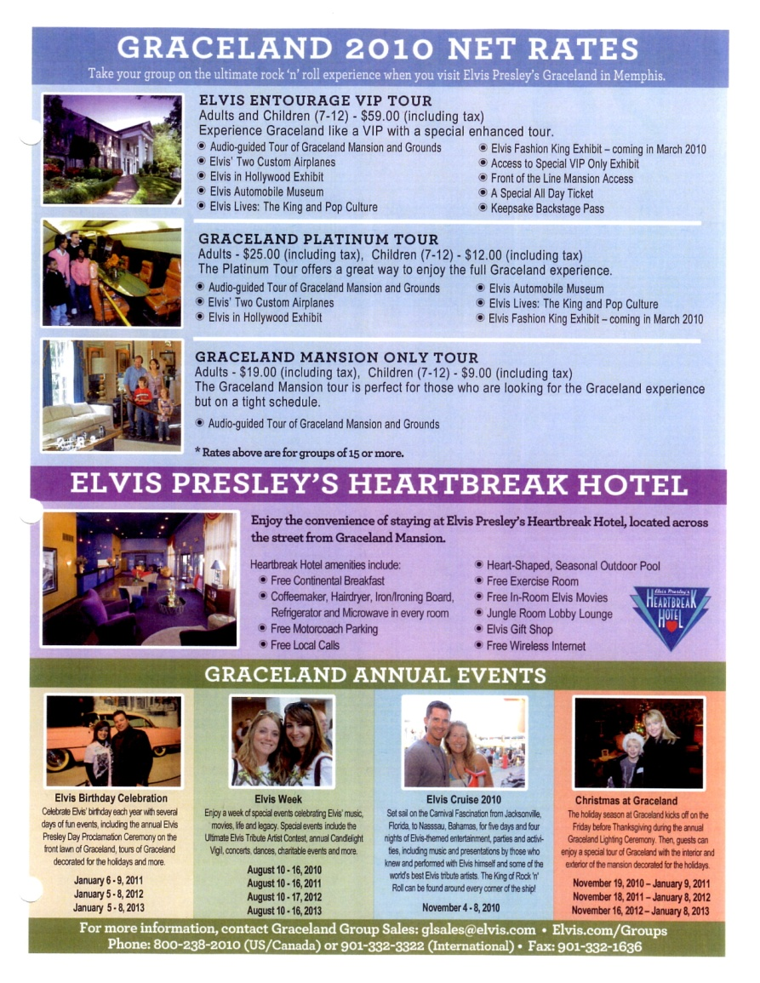
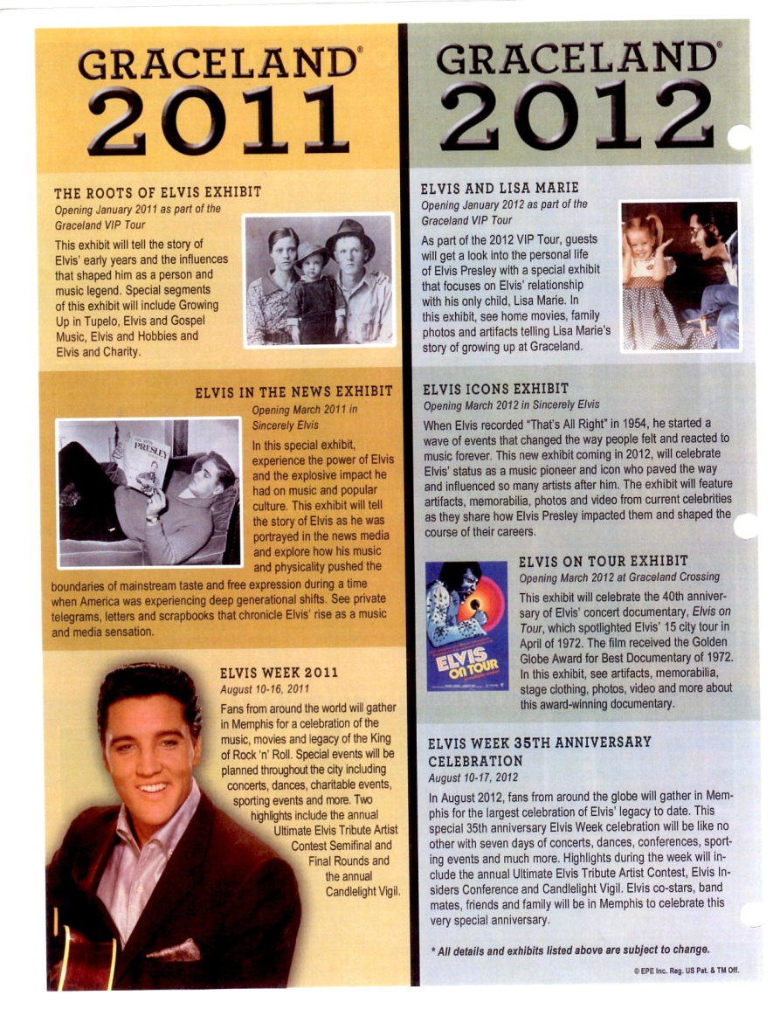

Slide 21
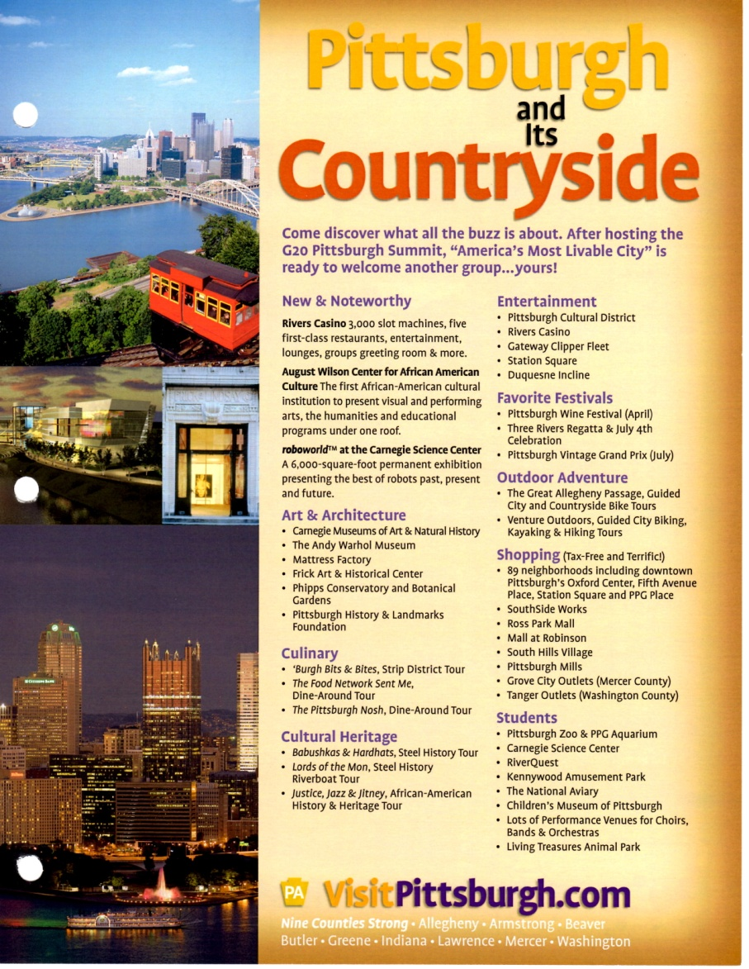
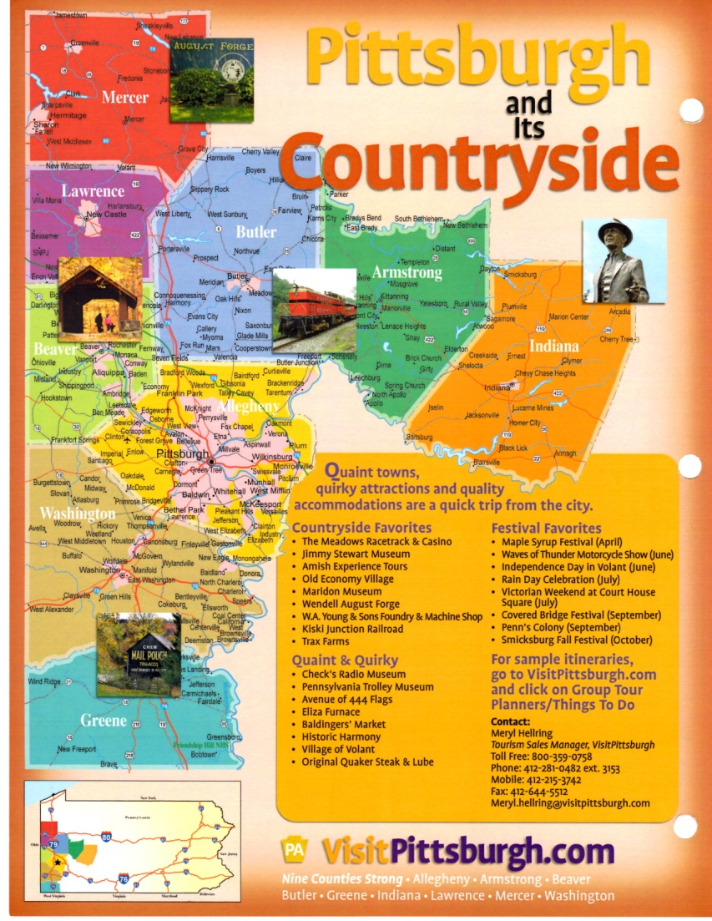

Slide 22
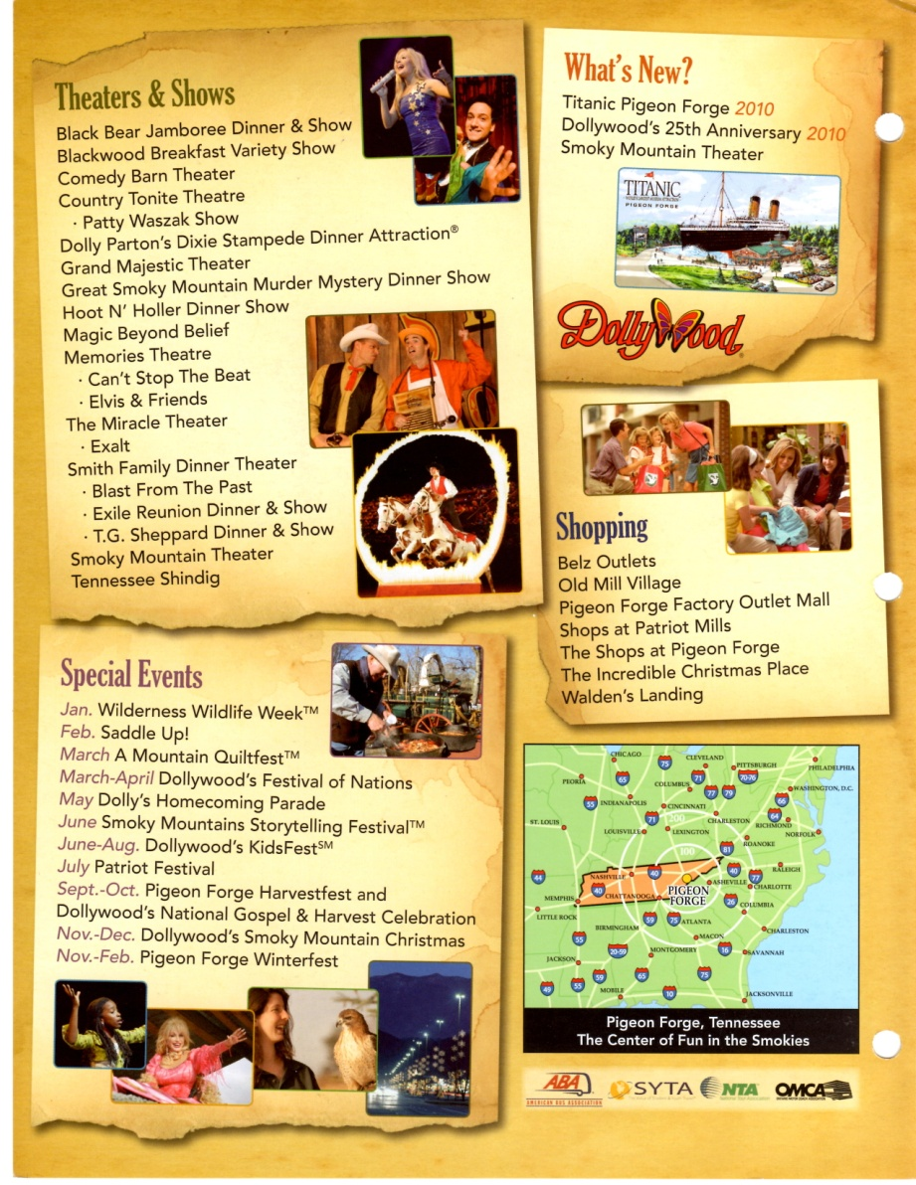

Slide 23
Familiarization Tours
Commonly know as:
FAM Tours

Slide 24
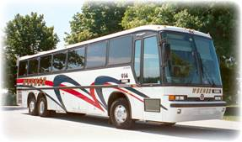
FAM Tours
Offered to Operators
Offered to Operators who bring Group Leaders

Slide 25
Benefits of a FAM
Exposure
Exposure
Exposure

Slide 26
What do you sell on a FAM?
1.Operator
2. Region
3. Your Property

Slide 27
the 3 P’s of a FAM Sales Presentation
Professional
Personal
Precise

Slide 28
Great way to showcase your property and services.
Services are usually provided at no or minimal cost.
Don’t forget it is also about your destination too.
Don’t “give away the whole farm”. Each FAM stop should be about 20 minutes.
Sell back to the operator who brought the group.
Remember to follow up.

Slide 29
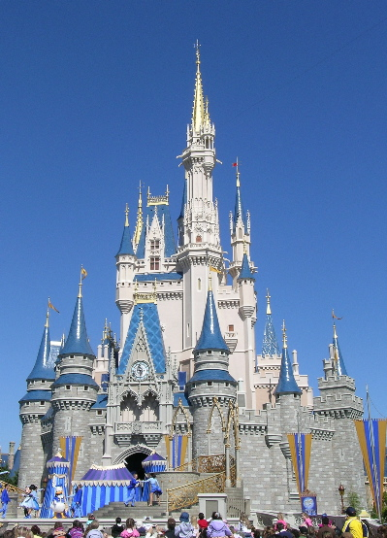
Playing Well With Others

Slide 30
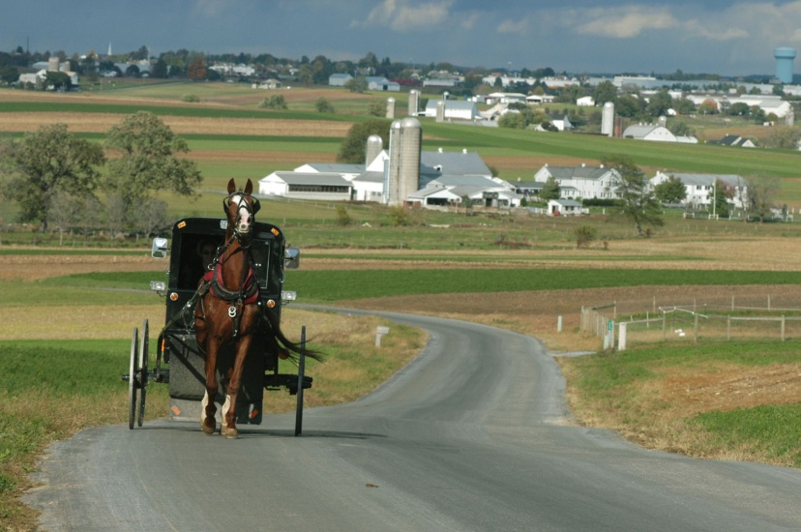

Slide 31
Attractions:
Do hoteliers and restaurants near you know what you have to offer?
Share your special events.
Invite others to experience what your property offers (even competitors).
Restaurants:
Do Hoteliers and attractions near you know what you have to offer?
Do you have special culinary packages?
Do you provide offsite services?
Hotels:
Do restaurants and attractions near you know what you have to offer?
Do you offer special entities no one else does?

Slide 32
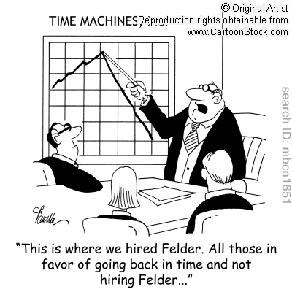
Does your DMO know you?
Are you providing them with all your valuable info?
This info is put to work to help bring marketing dollars into your area.
All names are kept in confidence – only numbers are shared.
Are you letting them know when you hired someone new or you move on?

Slide 33
DMO’s are your greatest partner.
DMO’s can help you stretch your marketing dollars.
DMO’s offer great networking opportunities.
DMO’s offer sales missions.
DMO’s offer group sales meetings for sharing ideas.
Remember…your DMO’s job is to bring groups
to your area. Your job is to bring those
groups to your property.

Slide 34
There’s no Business Like Show Business!
Show Tip #1
Attend ALL Sessions at ALL Shows
Show Tip #2
Learn how to Network
Show Tip #3
You Must Be Seen to be Remembered

Slide 35
There are basically three types of shows:
Scheduled Appointment Shows
Stand In Line & Wait Appointment Shows
Booth Trade Shows

Slide 36
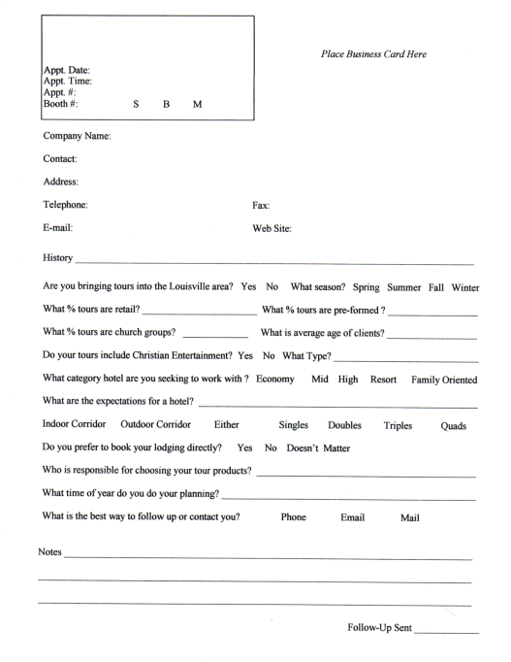

Slide 37
Scheduled Appointment Shows
Before The Show
Register On Time
Do Your Research – Review profiles, view web sites, know what they are looking for. Choose appointments.
Prepare Your Marketing Materials – Profile Sheet & Business Card
Talk To Other From Your Area – See who is doing business with whom. Can you partner with them to reach them with a bigger itinerary?
Internal Database – Have they visited your property before? Are there any comments about past visits?
Door Prize – Something that assures a booking for your property. Give an incentive and your door can work for you.

Slide 38
At The Show
Timed Appointments – Will have an assigned time to be on the floor. Strict seven minute increments.
Number of Appointments – May have a full book and if not, have an opportunity to pick up appointments.
Session Starts – Go directly to your first scheduled table. Will have about 5 minutes at each table. Will receive a one minute warning. When bell rings, current appointment is over and next one begins. Don’t forget to say thank you with a hand shake or hug and be off.
What Do I Say? – Presentation should be a conversation and not a sale pitch. What is different, unique, and out-of-the-ordinary with your property? Get to know the operator. Talk with the operator not to the operator!
Relationship Industry – Relationships take time. Can take up to 3-5 years to build these relationships. Don’t get discouraged.

Slide 39
Stand In Line & Wait appointment Shows
Before The Show
Register On Time
Do Your Research – Review profiles, view web sites, know what they are looking for. Know who you want to speak to.
Prepare Your Marketing Materials – Profile Sheet & Business Card. You can offer a give away to be put on the table prior to the appointment.
Talk To Other From Your Area – See who is doing business with whom. Can you partner with them to reach them with a bigger itinerary?
Internal Database – Have they visited your property before? Are there any comments about past visits?
Door Prize – Something that assures a booking for your property. Give an incentive and your door can work for you.

Slide 40
At The Show
Appointments – Will choose who you would like to see first and then stand in line an wait for that operator to be free. You will have a7 to 10 minute appointment. If line is long, jump to another operator that is free and come back. Know who will be the most popular operators so you can see at least one of them first. When your appointment is finished, don’t forget to say thank you and depart.
Number of Appointments – Will vary. Be sure to see your top 10 list first and fill in if you have more time.
What Do I Say? – Presentation should be a conversation and not a sale pitch. What is different, unique, and out-of-the-ordinary with your property? Get to know the operator. Talk with the operator not to the operator!
Relationship Industry – Relationships take time. Can take up to 3-5 years to build these relationships. Don’t get discouraged.

Slide 41
Booth Trade Shows
Before the Show
Register On Time – This is a great show to partner with others in your area.
Prepare Booth Display – Many shows will have a theme and would expect you to decorate your booth to match the theme.
Prepare Handout Materials – Some shows may allow pricing, others do not. If doing a group leader show…NO PRICING should be on the handout materials. Take the number of people expected, divide by 2, and subtract a third. This will give you the number of handouts and material you will need.
Purchase Give Aways – Many times they end up with the grandkids! Candy is always a great alternative.
Door Prize – Something that assures a booking for your property. Give an incentive and your door can work for you.

Slide 42
At The Show
Be On Time To Set Up
Greet Everyone Who Comes To Your Booth – Even those who are just there for the give aways.
Ask If they would Like Your Info - These types of shows are difficult on the vendor but that is no reason to be rude. Ask if they would like your materials. If you just slip it in their bag, they will just throw it away and you have wasted your marketing dollars.
Have Better Give Aways In The Back For “Special Attendees” – If you know who is coming, send them a flyer offering them a “free” gift if they bring the flyer with them and stop at your booth. Give a larger gift to those prospects that you know will bring a group to your property.
Don’t Be Discouraged By The Numbers – It only takes
3 – 4 people to bring a group to your property to make up for a show. If you have spoken to four great prospects…you have done your job!
Don’t Tear Down Until Told To or At Designated Time

Slide 43
Follow Up
Most important part of sales but most overlooked!
You follow up because 98% of all sales are made after the 10th “NO”.
Write it down!!
Use a Show Sheet
Follow Up With:
Calls
Emails
Leads
Networking Opportunities
Be Creative!
Post Cards
Food
Louisville “Big” Campaign
NC Christmas Lights

Slide 44
What Do Operators look For?

Slide 45
From Destinations…
Sites en route
Milepost information
Marketing support materials
Scenic route options
Nearby areas of interest
Adequate, varied and nearby hotels, restaurants
and attractions
Communities that want business

Slide 46
From Attractions…
Adequate capacity to handle large groups
Special entrances
Good group seating with views for entertainment
Gift Shop
Clean and plentiful restrooms
Sitting areas
Helpful and friendly staff
Special concessions for groups
On-site food service

Slide 47
From Lodging…
Price within a budget
Location
Quality and service that matches need
Responsive sales staff
Favorable group discounts and comps
Double Doubles
Attractive and clean rooms
Safety and security
Large public areas
Good views
Breakfast facilities
Free coach parking

Slide 48
From Restaurants…
Quality food
Varied and interesting menu
Adequate seating in a good location
Interesting decor
Friendly , courteous staff
Efficient delivery
Coach access and parking
Group tour menu
Enthusiastic and responsive management
Mix of regular and tour patrons

Slide 49
What Operators want you to know…
Operators would like…
Interesting Operator facts…
Honesty
Call or email ASAP
Timed itineraries
More Sales Missions to offices
Better cancellation policies
Their group numbers are lower
They have limited time to work on planning
They are not lazy and want you to do their job
They are wanting the best for their clients

Slide 50
Industry Trends…
Scheduled Service
Green Transportation
Wi-Fi
International - BRIC
Smaller Group Numbers
Last Minute Bookings
Safety Criteria

Slide 51
Questions and (Hopefully) Answers!!
Thank you for allowing me to be a part of your day! Now…Go Out There and Get ‘Em!!!

