Slide 1

Monthly Board Report
July 2023

Slide 2
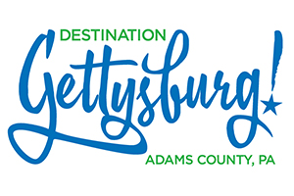
Monthly Summary
MONTHLY HIGHLIGHTS – JULY 2023
MARKETING
PARTNERSHIP
GROUPS/MEETINGS
COMMUNICATIONS
Website traffic up by 3.05% over July 2022.
Users, sessions and page views are all up over 2022.
Fourth of July event listing attracted nearly 12,000 visits.
Launched new social media channel - Threads
More than 81,000 copies of Visitors Guide are distributed in first five months.
Five businesses have signed on as a partners of Destination Gettysburg:
Gettysburg Chamber Orchestra
Karen Tavenner, Realtor
Trevanion
RSP Partners
Farmstead Butcher
Hosted Three-Day FAM Tour for Meeting Planners.
Hired a new Sales Manager, Diana Packard!
Making final preparations for first Gettysburg Girl Scout Day on Sept. 30.
Working with Community Media for new Keystone Crossroads video.
Gettysburg gets 10-second spotlight on The Today Show.
Attended MATPRA Media Marketplace in Maryland and met with 20+ journalists from around the country.
Open Rate for July’s Monthly Newsletter exceeds 31 percent.
Summer Social event scheduled for Aug. 8.
Planning Group Tour training session on August 24.
2

Slide 3
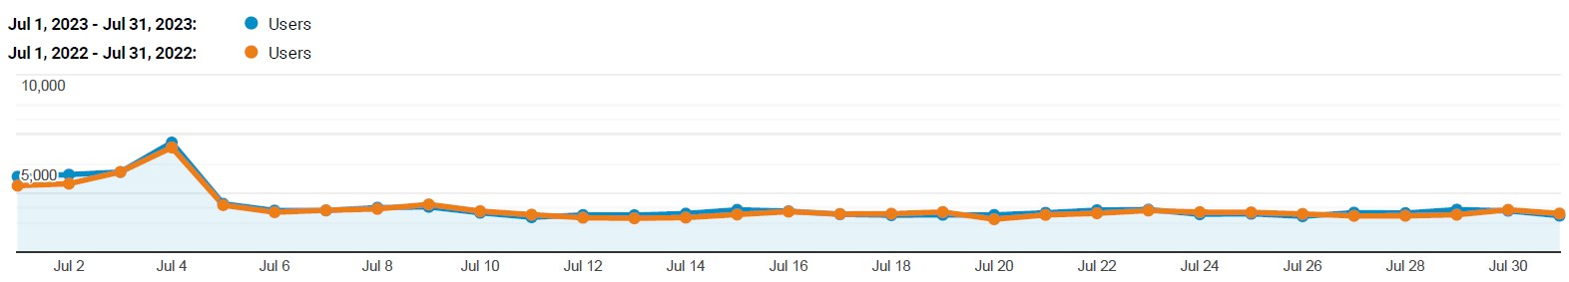




DestinationGettysburg.com
MONTHLY HIGHLIGHTS – JULY 2023
Monthly Website Traffic
AT A GLANCE
Acquisition:
Organic Search – 71.4%
Direct – 10.9%
Paid Search – 8.4%
Display Ads/Other – 3.5%
Referral – 2.9%
Social – 2.7%
Top Visited Pages
Things to Do – 17,677
Homepage – 17,255
Event Calendar – 14,572
Fourth of July Event – 9,731
Blog – Must Dos – 6,573
Top Geo Locations
Pennsylvania – 27.76%
Virginia – 10.30%
New York – 7.54%
Ohio – 5.79%
Maryland – 5.54%
Age Breakdown
18-24 – 10.20%
25-34 – 17.05%
35-44 – 22.50%
2023 – 69,767
2022 – 67,700
2021 – 79,188
2023 – 66,209
2022 – 64,883
2021 – 75,451
2023 – 233,705
2022 – 203,639
2021 – 278,892
2023 – 92,255
2022 – 88,237
2021 – 105,941
45-54 – 19.59%
55-64 – 18.27%
65+ - 12.39%
3

Slide 4
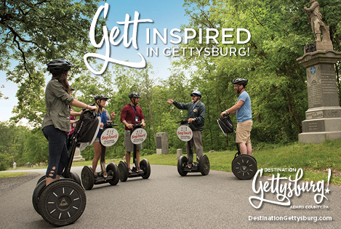


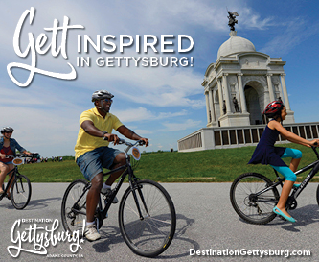
Digital/Video Marketing
MONTHLY HIGHLIGHTS – JULY 2023
AT A GLANCE
Display
2,092,030 Total Impressions Delivered
.042% Click-Through Rate
4,882 Landing page visit totals
Video (Online Video + CTV)
169,234 Impressions Delivered
84.54% Player Completion Rate
Google AdWords
123,457 Impression Total
42,813 Search Impressions
6,995 Clicks
16.34% Click-Through Rate
80,644 YouTube Impressions
Top Performing Search Keywords
“visit gettysburg”
[things to do gettysburg]
“gettysburg bed and breakfast”
“places to stay in gettysburg”
4

Slide 5
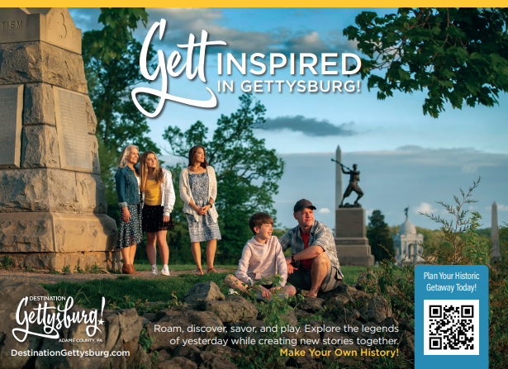
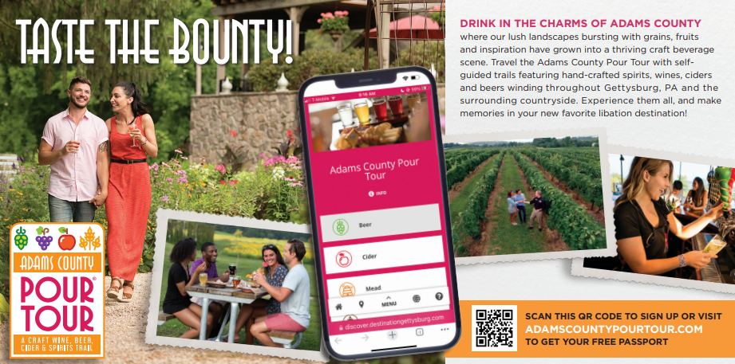
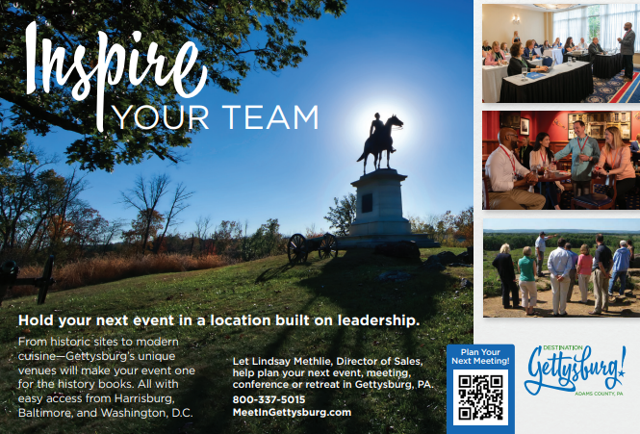
Print/New Creative
MONTHLY HIGHLIGHTS – JULY 2023
More Placements:
USA Today Travel Guide
Edible Jersey and Philly
Gettysburg Times
Group Tour Magazine
The Burg
Pittsburgh Post Gazette
AAA World
Mid-Atlantic Media (Meetings)
6

Slide 6
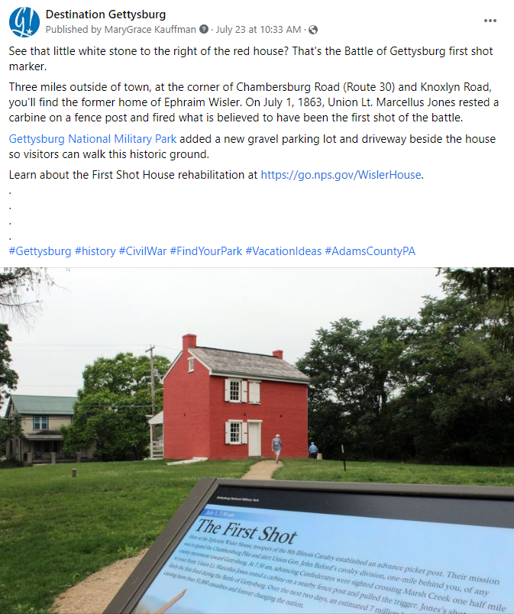
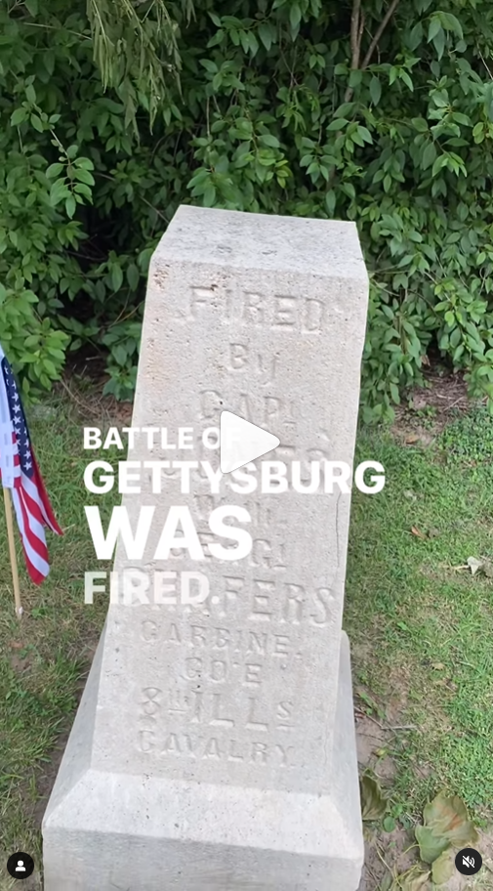
Facebook and Instagram
MONTHLY HIGHLIGHTS – JULY 2023
FACEBOOK
33 Posts
10,186 Engagements
898 Shares
47,873 Followers
Likes: 2,170
Views: 48.1K
Reach: 14,061
Comments: 11
INSTAGRAM
53 Posts & Stories
7,593 Engagements
86,359 Reach
51,970 Impressions
9,644 Followers
Reactions: 1,573
Comments: 34
Shares: 153
6
Notes:
IG and Facebook engagement are up from last month, Facebook shares doubled, followers grew by a few hundred on each platform
(Followers pulled from Meta, other stats pulled from Hootsuite)

Slide 7
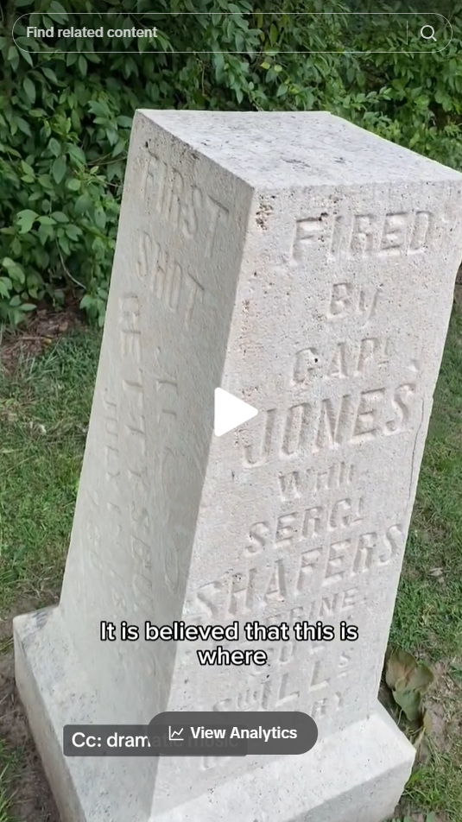
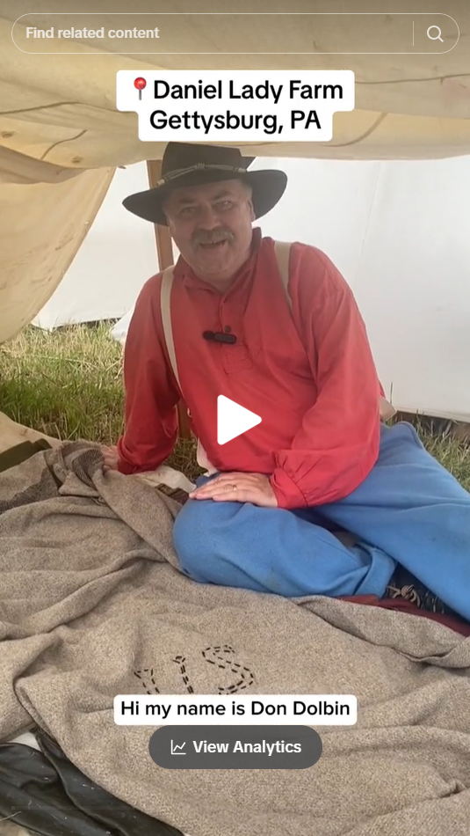
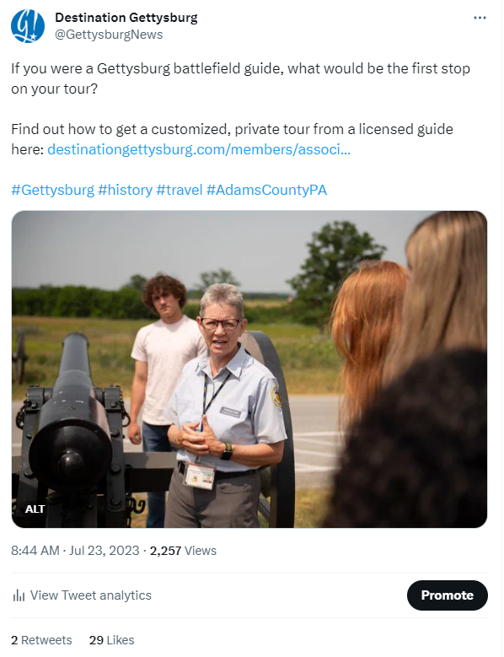
TikTok and Twitter
MONTHLY HIGHLIGHTS – JULY 2023
TikTok
Twitter (X?)
TIKTOK
9 Videos
8,328 Followers
TWITTER
30 Posts
7,790 Followers
Views: 2,257
Likes: 29
Views: 18.5K
Likes: 1,141
Views: 7,696
Likes: 402
7
Notes:
TikTok continues to be our fastest growing platform, with followers up by more than 1,000 this month over last month. Of note, Twitter rebranded as X this month. We are proceeding as usual with our Twitter content.

Slide 8
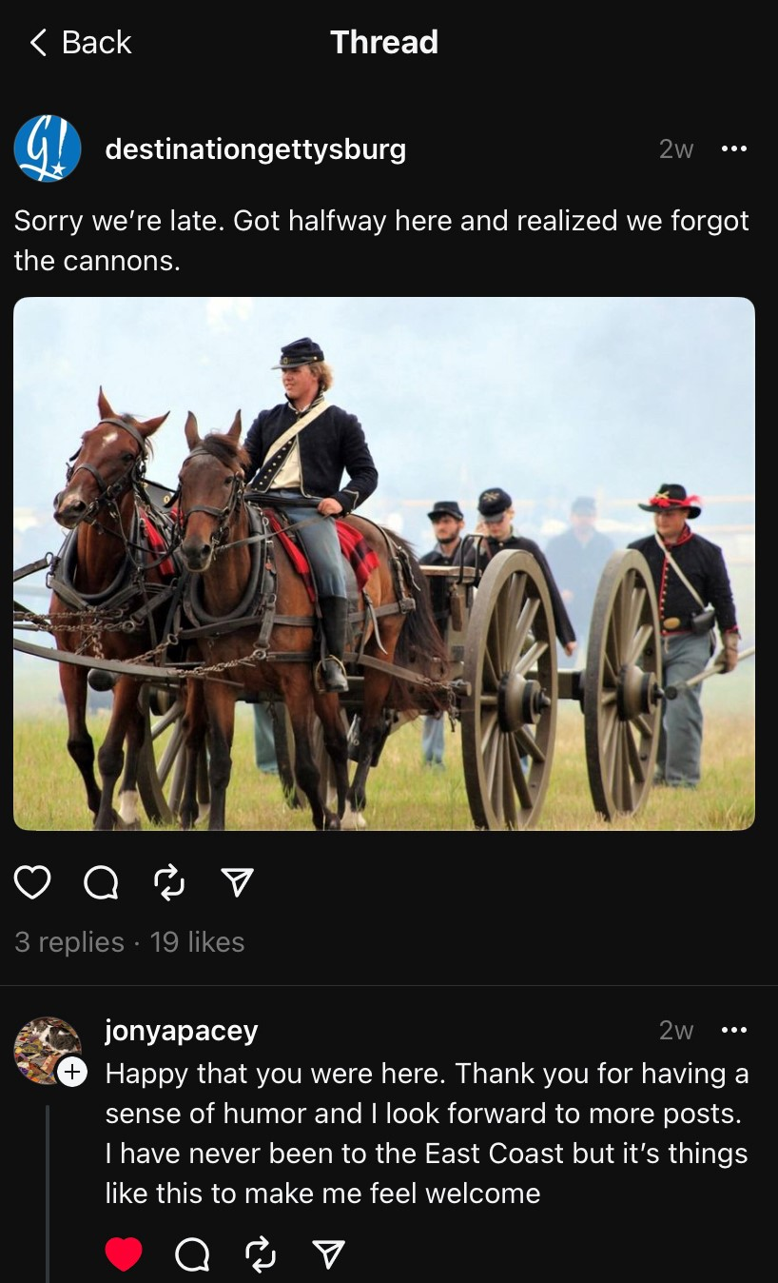
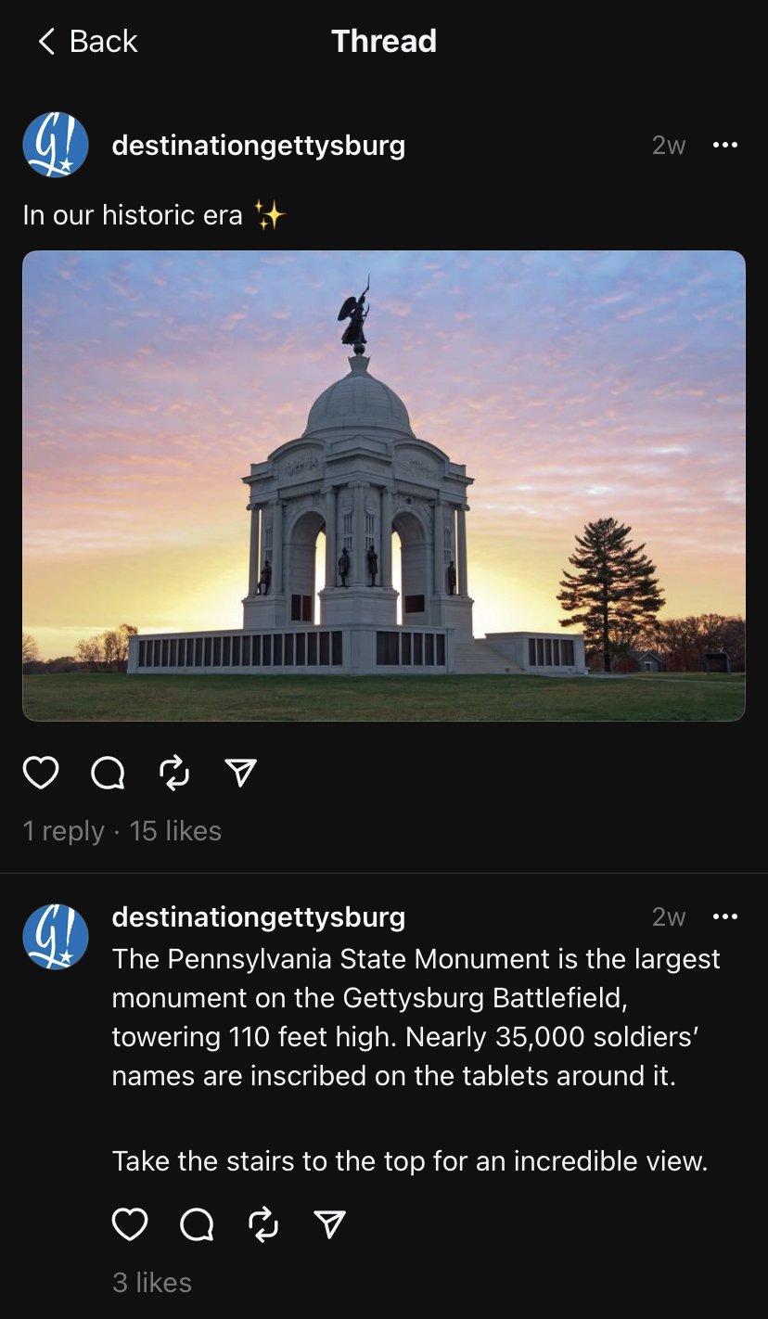
New platform: Threads
MONTHLY HIGHLIGHTS – JULY 2023
What is Threads?
THREADS
6 Posts
750 Followers
Launched July 5
Meta’s answer to Twitter
Connected to Instagram
Posts up to 500 characters long, able to include links, photos and up to 5-minute videos. No DM feature.
Mobile-first app. No desktop version.
30 million users signed up the first day, 100 million within the first week.
However, users and daily usage are on the decline.
Many DMOs are taking a lighthearted, humorous approach to posts.
8
Notes:
Not certain Threads is here to stay, but we will monitor activity going forward.

Slide 9

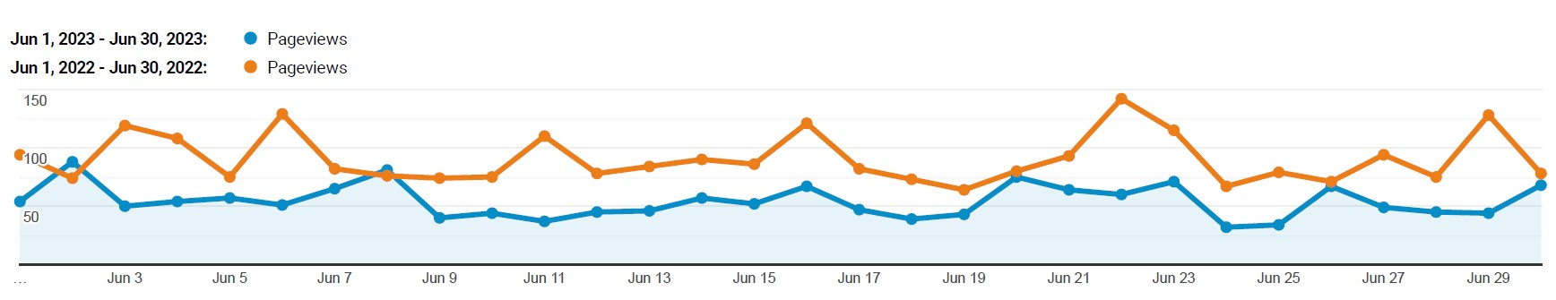

Adams County Pour Tour
WEBSITE AND DIGITAL HIGHLIGHTS – JULY 2023
Monthly Website Traffic
WEBSITE
Page Views
1,817 Views in July 2023
Down 31.54% YOY vs. 2022
Down 32.23% YTD vs. 2022
Top 6 Web Pages
Homepage
Wine
Map
Beer
Itineraries
Spirits
DIGITAL MARKETING
Digital Passport:
Passport sign-ups: 209
Digital check-ins: 556
Redemptions: 35
Newsletter OR: 44%
Display Advertising
244,238 Total Impressions Delivered
.053% Click-Through Rate
180 landing page visits
320 approximate DG Zone location visits.
Google AdWords
3,664 Search Impressions
248 Clicks
6.81% Click-Through Rate
Top Performing Search Keywords
gettysburg pour tour
+pour +tour
wine tasting
+wine +trails +near +me
8

Slide 10
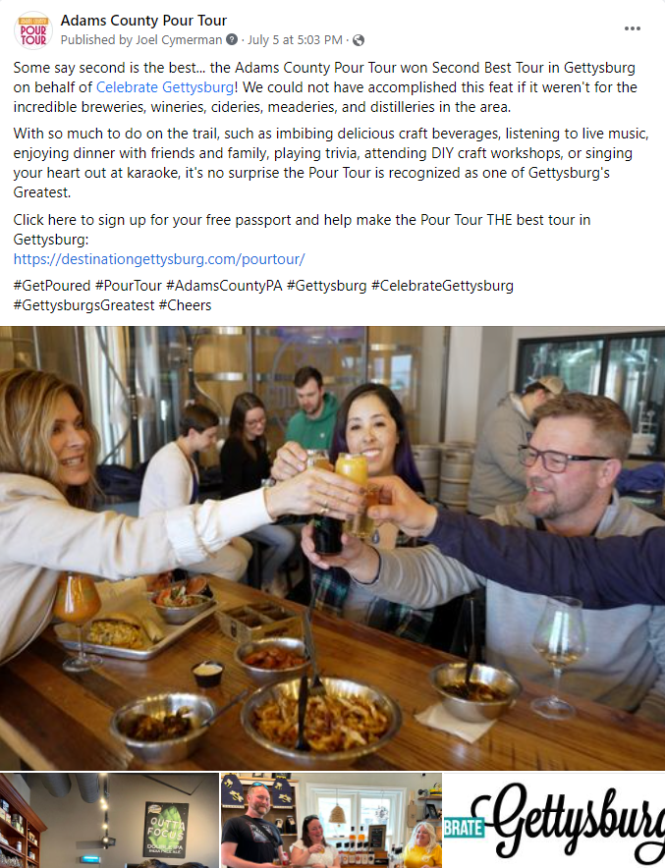
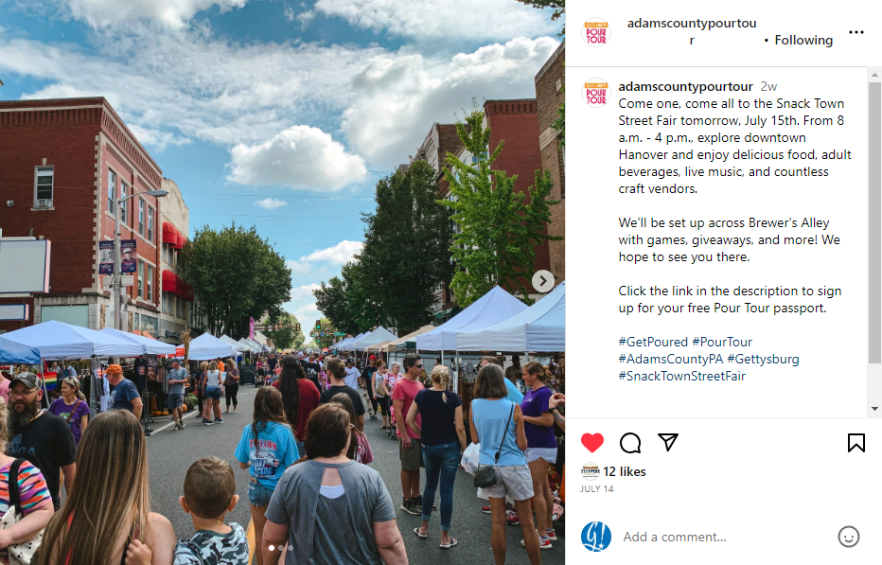
Adams County Pour Tour
SOCIAL MEDIA HIGHLIGHTS – JULY 2023
Facebook
Instagram
FACEBOOK
11 Posts
214 Engagements
11 Shares
2,130 Followers
INSTAGRAM
10 Posts
117 Engagements
1,124 Followers
Reactions: 23
Comments: 2
Shares: 5
Likes: 12
Reach: 224
9
Notes:
FYI followers are as of Aug. 4

Slide 11

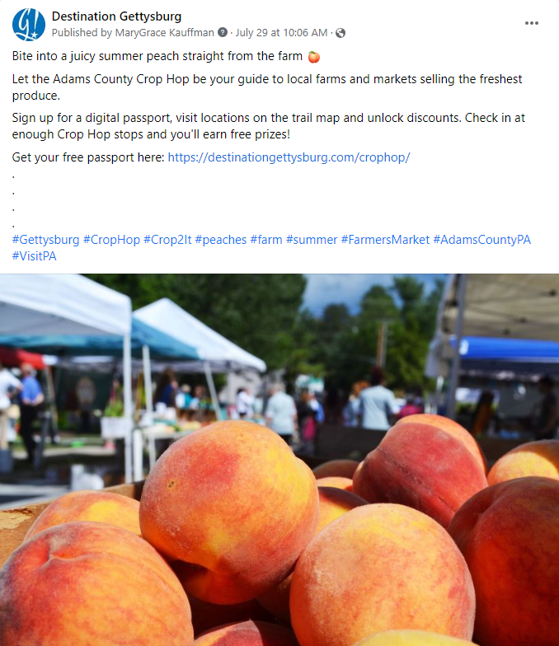
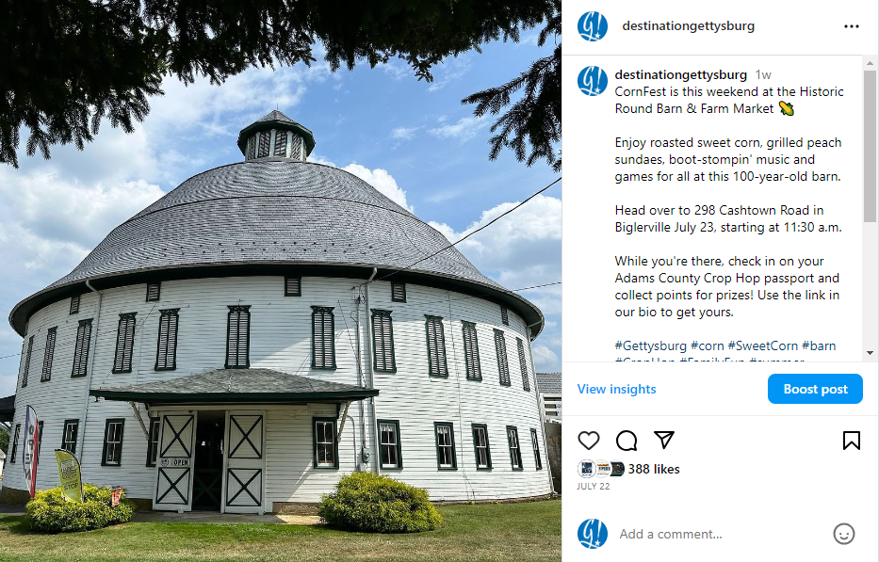
Adams County Crop Hop
MONTHLY HIGHLIGHTS – JULY 2023
Facebook
Instagram
AT A GLANCE
60 sign-ups
79 check-ins
10 discounts redeemed
6 prizes redeemed
49% newsletter OR
Reactions: 69
Shares: 2
Comments: 2
Likes: 388
Reach: 3,714
10

Slide 12
Partnership
MONTHLY HIGHLIGHTS – JULY 2023
Meetings/Visits with Current Partners
AT A GLANCE
Patriots of the Civil War
World War II American Experience Museum
Jennie Wade House
Aramark / Refreshment Saloon
Ticket to the Past
David Wills House
Gettysburg Smoothie Co.
Gettysburg Goods
Partnership
316 Total Partners*
New/Returning Partners
Gettysburg Chamber Orchestra
Karen Tavenner, Realtor
Trevanion
RSP Partners
Farmstead Butcher
Partnership Engagement
8 Partner Meetings/Training
Going Places Newsletter
July 6– 57.5% Open Rate
July 19 – 60.8%
Meetings with Potential Partners
Gettysburg Chamber Orchestra
RSP Partners
Karen Tavener, ReMax Quality Service
Upper Crust / Gallery 30 / Borough BBQ
Gettysburg Cigar Company
Trevanion
Upcoming Partnership Events
Summer Social Celebration –August 8
Group Sales 101 – August 24
11

Slide 13
Groups and Meetings Market
MONTHLY HIGHLIGHTS – JULY 2023
Sales and Marketing Highlights
AT A GLANCE
Engagement:
Group Tour – 30 contacts
Meetings Market – 50 contacts
Upcoming Communication:
August – Group Mkt. Newsletter
September – Meetings Newsletter
Partner meetings/site visits with Gettysburg Foundation, Trina Kay, Gettysburg Mercantile Museum, Reluctant Witnesses
Hosted 13 meeting planners for a 3-day FAM
Keystone Crossroads Meeting
Hired and training of new sales manager
Hosted meeting with partners to discuss upcoming Girl Scout Day event
Call girl scouts to discuss program partnership
Call with Community Media to discuss potential Keystone Crossroads Video opportunities
Call with other DMOs to discuss PA group tour sales mission
Call with other DMOs to discuss PA sales mission to international receptives
Site inspections for PA DUI Association 2025 annual conference
Appointment requests and research for SYTA Conference
Sent out 7 RFPs totaling 1,147 room nights
Upcoming Marketplaces
SYTA- August 15-22, 2023
Maryland Motorcoach- September 26, 2023
Greater NJ Motorcoach- October 5, 2023
12

Slide 14
Media and Communications
MONTHLY HIGHLIGHTS – JULY 2023
Notable Media Coverage
AT A GLANCE
Total Placements: 145
Noteworthy Stories:
(*Notes Stories Made Possible through DG Efforts)
The Prettiest Cities in Pennsylvania ABC 27/World Atlas Southcentral Pa.
*Beyond the Battle: A Civilian Perspective TravelAwaits.com Unspecified
Vacations to Inspire Your National Security Journey ClearanceJobs.com National
Feature on Mister Ed’s Elephant Museum Centre Daily Times Central Pa.
Experience Flavors of Gettysburg with a Food Tour FamilyTravelsUSA.com Unspecified
Navigating Busy National Parks This Summer The Today Show National
Ten Greatest Battlefields Around the World MSN National
Gettysburg is Quite a Trip – in Length and Learning Meadville Tribune Western Pa.
Eleven of the Most Haunted Places in the U.S. Yahoo! Life National
*Talking All Things Gettysburg Travel Itch Radio National
Best Educational Trips for Kids This Summer UpgradedPoints.com National
Attended MATPRA Media Marketplace in Montgomery County, Md.
Consumer Communications
Contact List –
77,443 names
Consumer Newsletter
July – 31.1%
Upcoming Media Pitches
Fall Travel Season
Holiday Season
Other Media Efforts
13

Slide 15
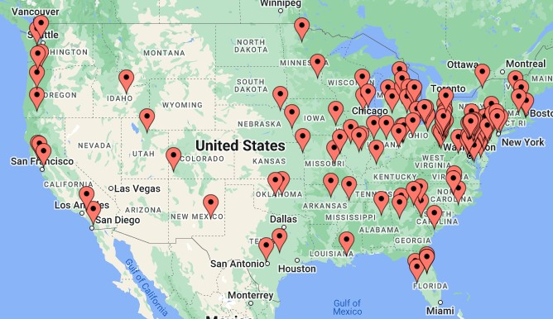
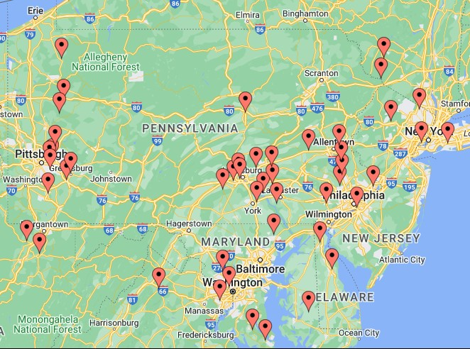
Visitor Services
MONTHLY HIGHLIGHTS – JULY 2023
Our visitors, by ZIP Code …
AT A GLANCE
Visitors Requesting Info:
Visitor Center/Admin – 506
Most frequent topics/questions:
Kid-friendly Attractions
Where to Eat
Ice Cream
Guides Distributed: 8,109
Online Guide Views: TBD
Also:
Quebec
Ontario/Alberta
South Holland
14

